Slide 1
Current State of Deep Learning in Hydrological Modelling
Evolución desde redes recurrentes hasta modelos fundacionales globales.

Slide 2

CONTENTS OF THIS TEMPLATE
Fonts
Colors
Thanks slide
Icons and infographics
To view this template correctly in PowerPoint, download and install the fonts we used
You can see on the link all the colors used in this presentation
You must keep it so that proper credits for our design are given
These can be used in the template, and their size and color can be edited
For more info:
SLIDESGO | SLIDESGO AI TOOLS | BLOG | FAQs
You can edit the master slides easily. For more info, click here
You can visit our sister projects:
FREEPIK AI TOOLS | FREEPIK LIBRARY RESOURCES
You can delete this slide when you’re done editing the presentation

Slide 3
TABLE OF CONTENTS
01
02
03
04
NAME OF THE SECTION
NAME OF THE SECTION
NAME OF THE SECTION
NAME OF THE SECTION

Slide 4
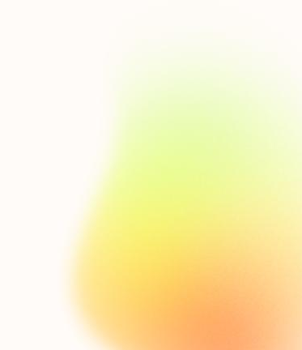
THE SLIDE TITLE GOES HERE!
Do you know what helps you make your point clear?
Lists like this one:
They’re simple
You can organize your ideas clearly
You’ll never forget to buy milk!
You can replace the image. Just right-click on it and select “Replace image”

Slide 5
01
NAME OF
THE SECTION

Slide 6
LET’S HAVE A LOOK
Mercury is the closest planet to the Sun and the smallest one in the entire Solar System. This planet’s name has nothing to do with the liquid metal, since Mercury was named after the Roman messenger god. Despite being closer to the Sun than Venus, its temperatures aren't as terribly hot as that planet’s. Its surface is quite similar to that of Earth’s Moon, which means there are a lot of craters and plains. Speaking of craters, many of them were named after artists or authors who made significant contributions to their respective fields. Mercury takes a little more than 58 days to complete its rotation, so try to imagine how long days must be there!

Slide 7
TWO IDEAS
VENUS
Venus has a beautiful name and is the second planet from the Sun. It’s hot and is the second-brightest natural object in the night sky
MERCURY
Mercury is the closest planet to the Sun and the smallest one in the Solar System. This planet’s name has nothing to do with the liquid metal

Slide 8
THREE IDEAS
MERCURY
Mercury is the closest planet to the Sun and the smallest one in the Solar System
MARS
Despite being red, Mars is actually a cold place. It’s full of iron oxide dust
VENUS
Venus has a beautiful name and is the second planet from the Sun

Slide 9
SIX DIFFERENT IDEAS
MERCURY
VENUS
Mercury is the smallest planet in the Solar System
Venus is the second planet from the Sun
JUPITER
SATURN
Jupiter is the biggest planet in the Solar System
Saturn is composed of hydrogen and helium
MARS
NEPTUNE
Despite being red, Mars is actually a cold place
Neptune is the farthest planet from the Sun

Slide 10

A PICTURE IS WORTH A THOUSAND WORDS

Slide 11
OUR HISTORY
01
02
03
04
VENUS
SATURN
MARS
NEPTUNE
Venus is the second planet from the Sun
Saturn is a gas giant and has several rings
Despite being red, Mars is actually a cold place
Neptune is the farthest planet from the Sun

Slide 12
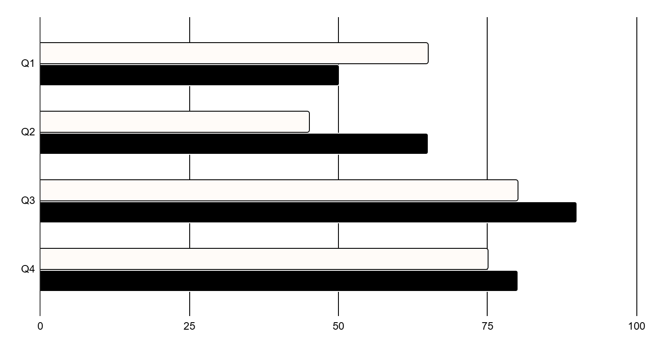
REPRESENT YOUR DATA HERE
YEARS | VENUS | MARS
XXXX | $0.30 | $31.90
XXXX | $3.90 | $15.40
XXXX | $157.30 | $212.54
XXXX | $3,368.20 | $2.154.68
NEPTUNE
MERCURY
Neptune is the farthest planet
Neptune is the farthest planet
Follow the link in the graph to modify its data and then paste the new one here. For more info, click here

Slide 13
333,000
386,00km
The Sun’s mass compared to Earth’s
Distance between Earth and the Moon

Slide 14
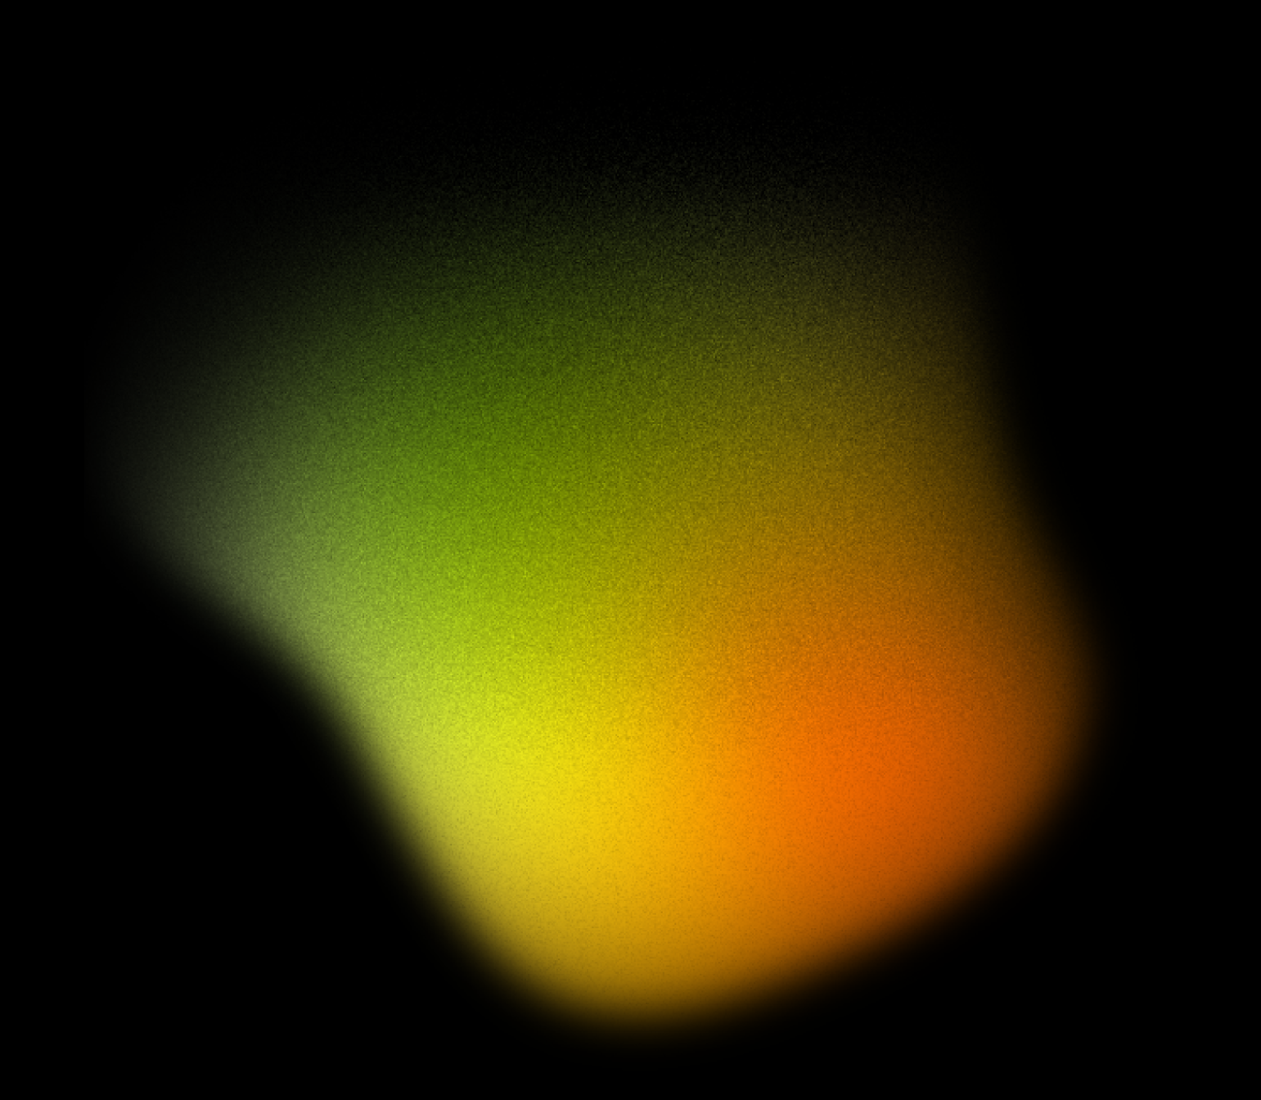
THANKS
Do you have any questions?
youremail@freepik.com
+00 000 000 000
yourwebsite.com
Please keep this slide for attribution

Slide 15
Instructions for use
If you have a free account, in order to use this template, you must credit Slidesgo by keeping the Thanks slide
As a Free user, you are allowed to:
Modify this template
Use it for both personal and commercial projects
You are not allowed to:
Sublicense, sell or rent any of Slidesgo Content
Distribute Slidesgo Content unless it has been expressly authorized by Slidesgo
Include Slidesgo Content in an online or offline database or file
Offer Slidesgo templates (or modified versions of Slidesgo templates) for download
Acquire the copyright of
Slidesgo Content
For more information about editing slides, please read our FAQs or visit our blog

Slide 16
Instructions for use (premium users)
As a Premium user, you can use this template without attributing Slidesgo or keeping the Thanks slide
You are allowed to:
Modify this template
Use it for both personal and commercial projects
Share this template in an
editable format
Hide or delete the “Thanks” slide and the mention to Slidesgo in the credits
You are not allowed to:
Sublicense, sell or rent any of Slidesgo Content
Distribute Slidesgo Content unless it has been expressly authorized by Slidesgo
Use any of the elements that are part in a separated way
Register any of the elements as a trademark or logo in an intellectual property registry
For more information about editing slides, please read our FAQs or visit our blog

Slide 17
Fonts
Colors
This presentation has been made using the following fonts:
All the colors used in this presentation
Click on the button of the link to the fonts
#000000
Viaoda Libre
#fffbf8
Albert Sans
To view this template correctly in PowerPoint, download and install the fonts we used

Slide 18
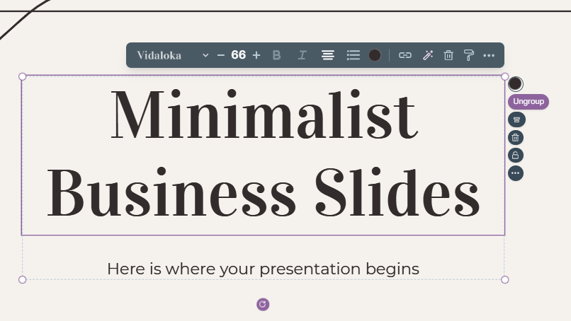
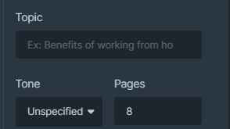
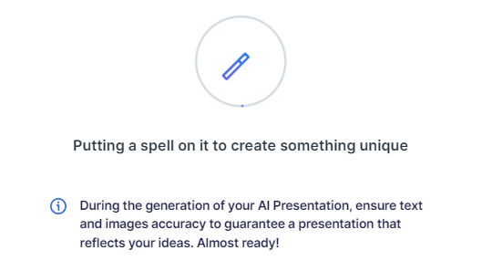
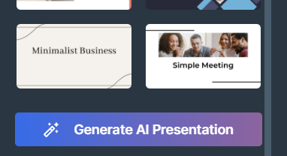
Presentation Maker
Slidesgo introduces its latest feature: the Presentation Maker. Enjoy two main functionalities - firstly, with a few clicks, create marvelous presentations with Artificial Intelligence that adapt to your needs. And it's completely free
Generate AI Presentation

Slide 19
Use our editable graphic resources...
You can easily resize these resources without losing quality. To change the color, just ungroup the resource and click on the object you want to change. You can also look for more infographics on Slidesgo

Slide 22
 | Jan | Feb | Mar | Apr | Jun
Task 1
Task 2
Task 3
 | No | Yes | Yes | No | Yes
 | Yes | No | Yes | No | Yes
 | Yes | Yes | No | Yes | No
 | Jan | Feb | Mar | Apr | Jun
Task 1
Task 2
Task 3

Slide 24
6/10 | 8/10 | 7/10 | 4/10

Slide 25
...and our sets of editable icons
You can resize these icons without losing quality
You can change the stroke and fill color; just select the icon and click on the paint bucket/pen
In Google Slides, you can also use Flaticon’s extension, allowing you to customize and add even more icons

Slide 26
Educational icons
Medical icons

Slide 27
Business icons
Teamwork icons

Slide 28
Help & support icons
Avatar icons

Slide 29
Creative process icons
Performing arts icons

Slide 30
Nature icons

Slide 31
SEO & marketing icons

Slide 32


